Slide 1

RFID based Smart Trolley using IoT
Main Project
Presented by:
IV B.Tech ECE-C Section
Batch No. ( C 18)
M.A.A.Ansari (17481A04C9)
M.Bhagya Raj (17481A04D1)
B. Pavan Kalyan (18485A0431)
Date : 17-07-2021
Under the guidance of
Mrs.L.Padmalatha
Assistant Professor
Department of ECE
Gudlavalleru Engineering College

Slide 2
CONTENTS
Objective
Introduction
Abstract
Block Diagram
Tools Required – (Software and Hardware)
Functions
Schematic Diagram
Advantages, Disadvantages and Applications
Result
Conclusion
References

Slide 3
Objective
Customers in a shopping mall usually wait for a long time for billing of items at the billing desk which is a complete wastage of time.
The Main Objective of this project is to design a automatic billing device using RFID and IoT in the trolley itself, thus reducing time for billing.
It is also User friendly and easy to use with minimal knowledge.

Slide 4
INTRODUCTION
This project is based on RFID interfaced to Node MCU which scans the RFID code and automatically starts billing which is sent to IoT webserver.
It also has a I2C LCD Module which displays the product and its price, when the customer decides to take an item or remove the item if he/she doesn’t require the product.

Slide 5
Abstract
Today’s world has a fast-growing population with a wide range of demand from a variety of domains. Customers who need to purchase different products in supermarkets needs lots of time in coordinating among them self for successful shopping.
We need to address this problem by efficiently using our technologies. In this system, we depict reasonable and cost-effective smart shopping cart utilizing IoT (internet of things) innovations. This framework helps in mechanizing the easy and comfortable billing process.
To achieve this, all products in the mall should be equipped with RFID tags and all trolleys should be equipped with a device which we have made to accelerate the whole process of shopping.
Further, we utilize IoT technology for displaying the items purchased in a HTML page connected through common server. We can easily monitor the items we are purchasing and their price.
We can also control our expenditure by removing the items which we don’t need in huge quantity. Hence the billing can be done in the trolley itself thereby saving a lot of time to the customers.

Slide 6
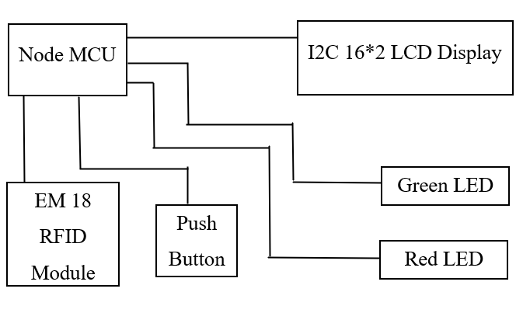
BLOCK Diagram

Slide 7
SOFTWARE Tools used
Arduino IDE
HARDWARE Tools used
Node MCU ESP8266
EM18 - RFID Reader Module
REES52 I2C Module
16*2 LCD Display
Push Button
Red LED
Green LED

Slide 8
Function
The RFID cards are first scanned to find out the unique codes corresponding to each card.
Coding part is implemented using corresponding RFID card values and is uploaded to Node MCU.
The corresponding Desktop and Node MCU must be connected to the same network with credentials which is used in the code so as to see the web server page of IoT.
When the customer needs any item, he/she scans the RFID card of item with the RFID module which starts billing of item which can be displayed on the LCD Display and blinking of Green LED, along with the billing page connected to webserver.
When the customer wants to replace or remove a product, he/she presses push button and again scans RFID card of product, so that the product is removed from billing which can also be displayed on the LCD and blinking of Red LED along with the billing page connected to webserver.
When the customer completes his shopping, he/she scans the master card which displays grand total on the LCD Display and blinking of Green LED along with Grand Total bill displayed on the webserver.
The Device is disconnected or reset button is pressed on Node MCU to reset the operation to initial state so that the trolley can be used by another customer.
This process saves lots of time for customer, as all the billing is done in the trolley itself.

Slide 9
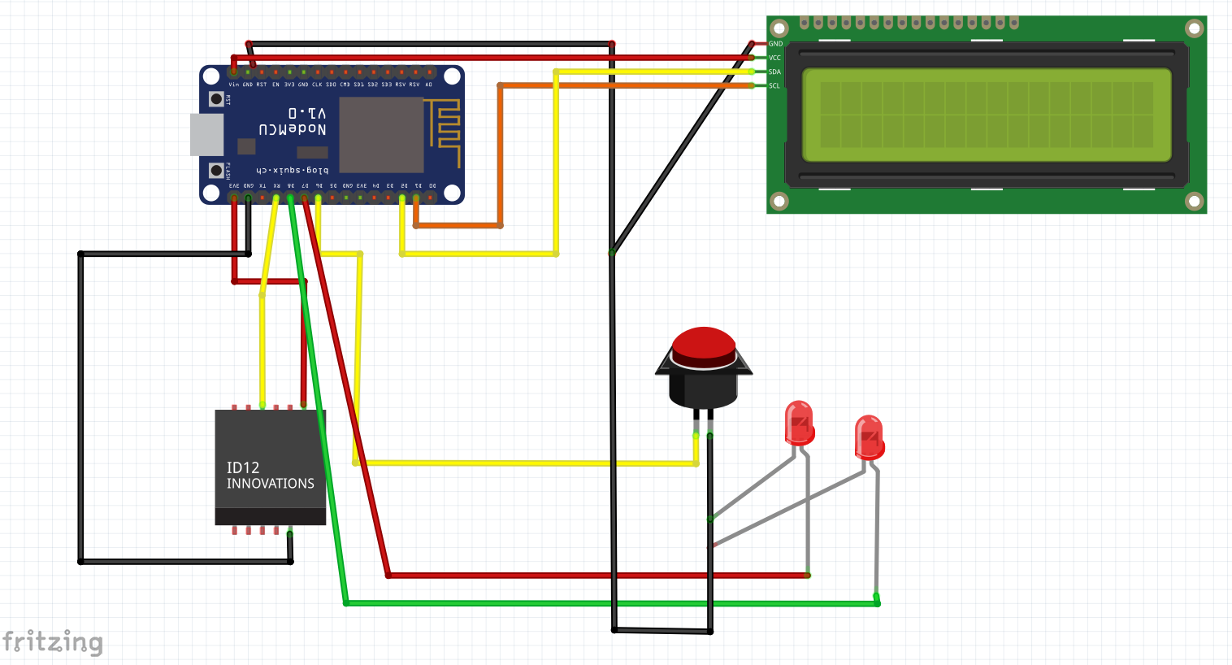
SCHEMATIC DIAGRAM

Slide 10
Advantages
Reduces time spent at billing counter and increases customer satisfaction.
Users can be aware of the total bill amount during the time of purchase which prevent them from over shopping.
Increases overall efficiency.
Allows quick checkout and eliminates waiting in long queues.
DISADVANTAGES
There should be minimal knowledge to use the device which forces people with illiteracy to switch back to conventional shopping system.
Applications
It can be utilized in Clothing Stores.
Grocery stores.
Wholesale shopping malls.
Vegetable marts

Slide 11
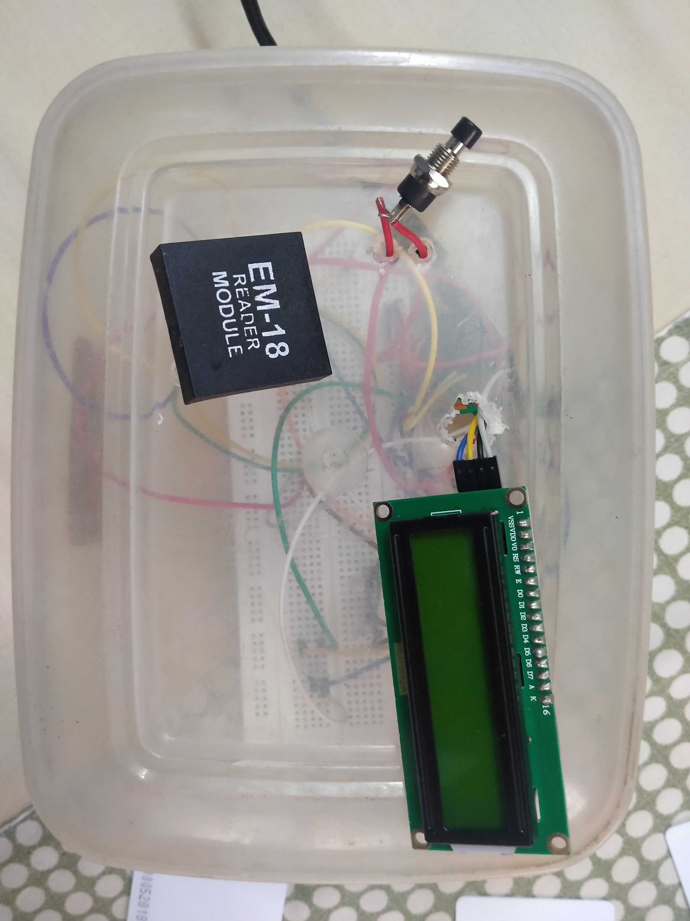
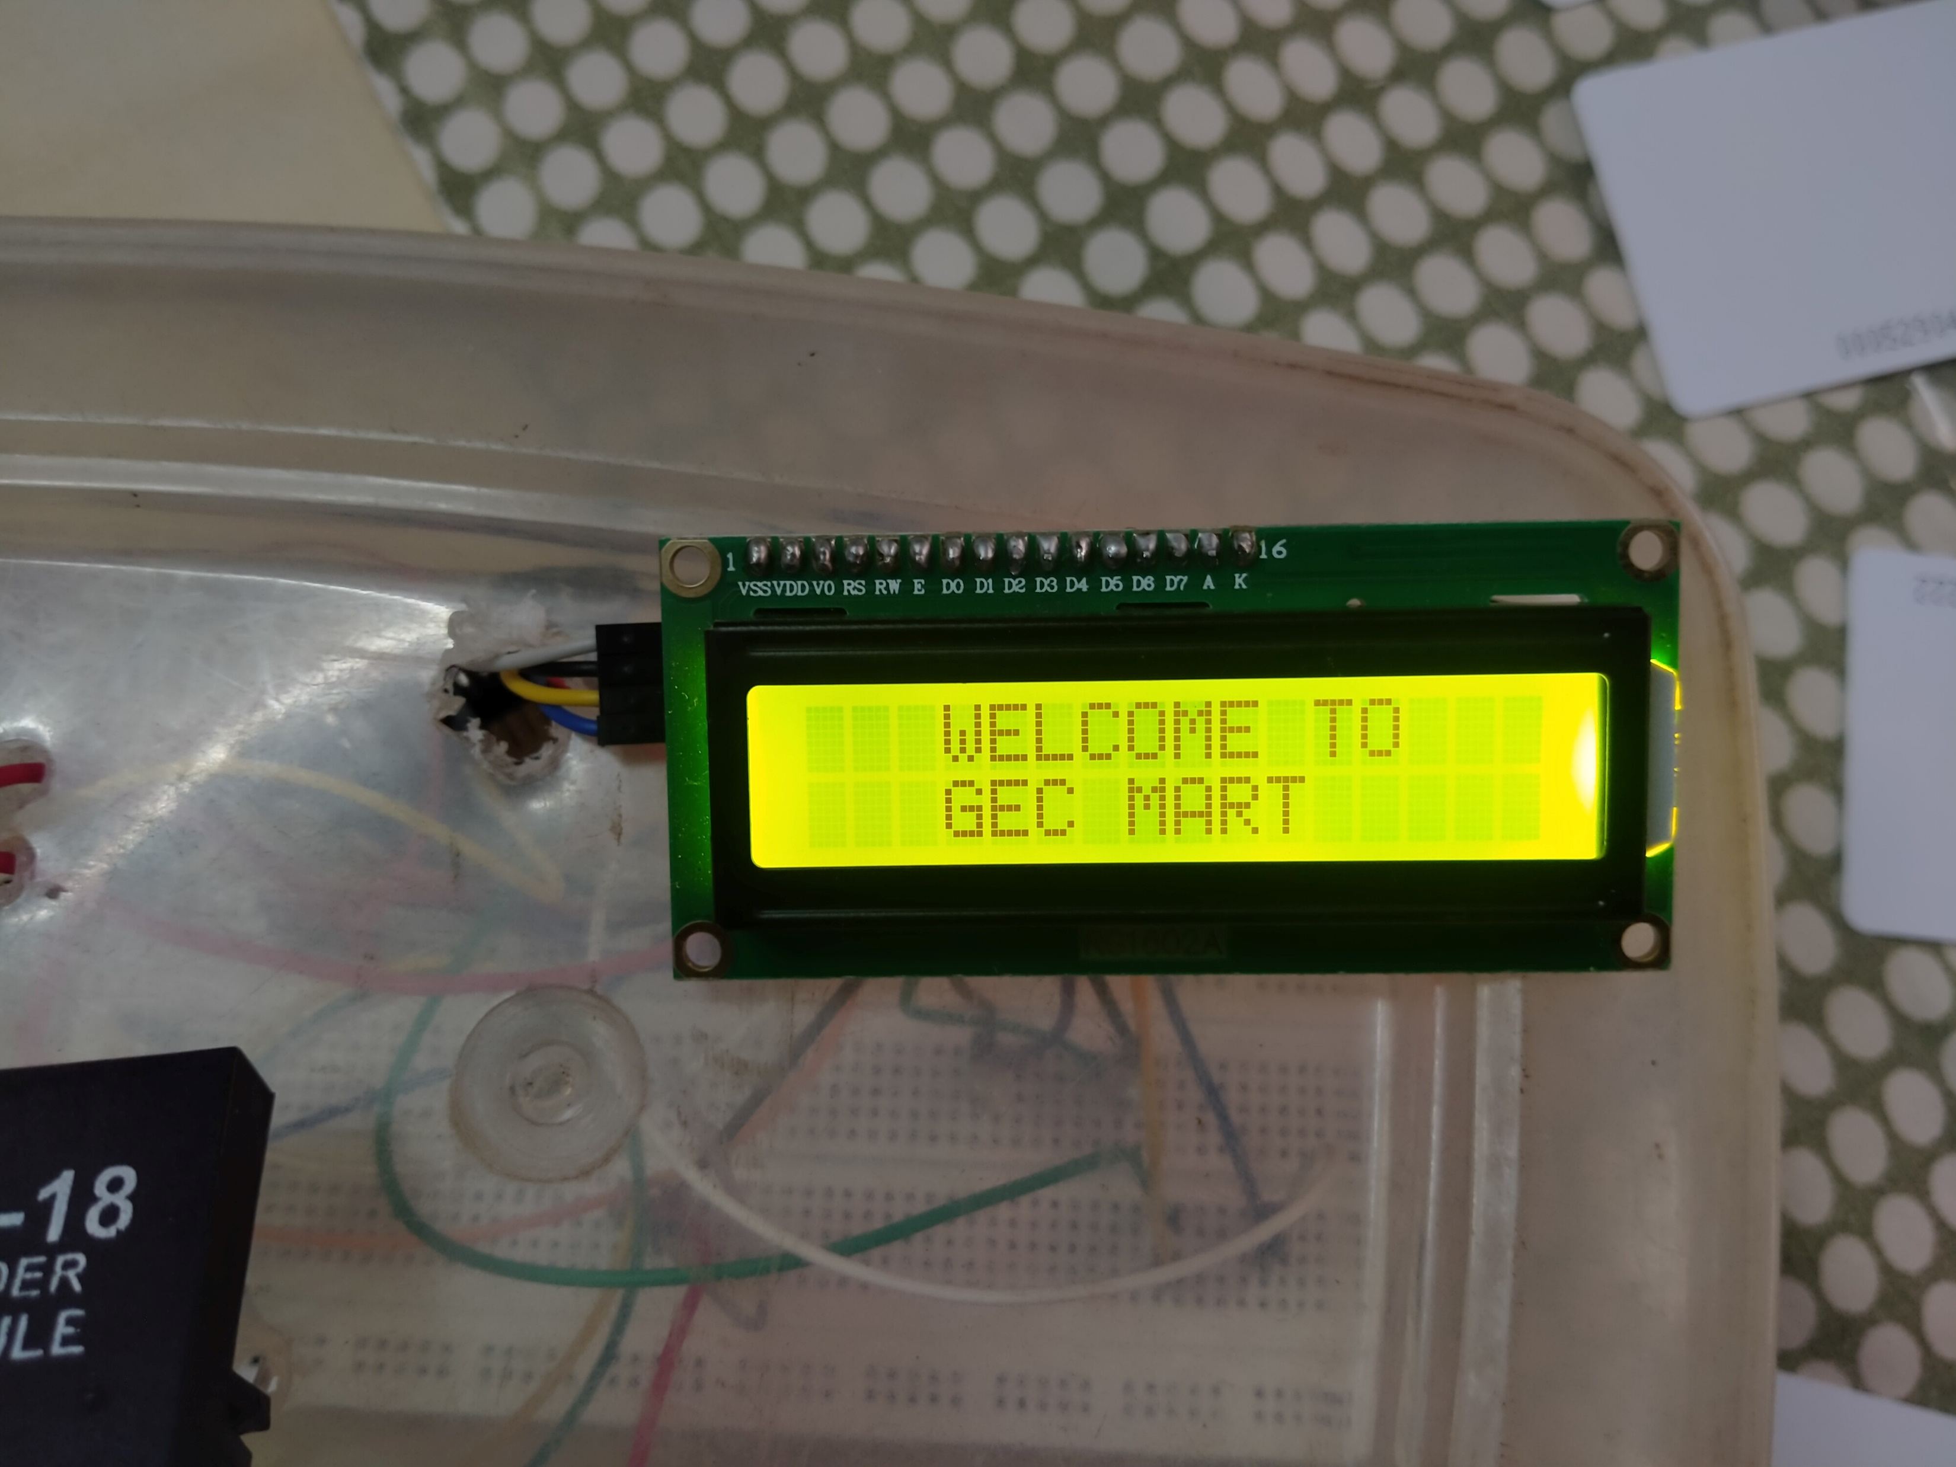
Initial STage

Slide 12
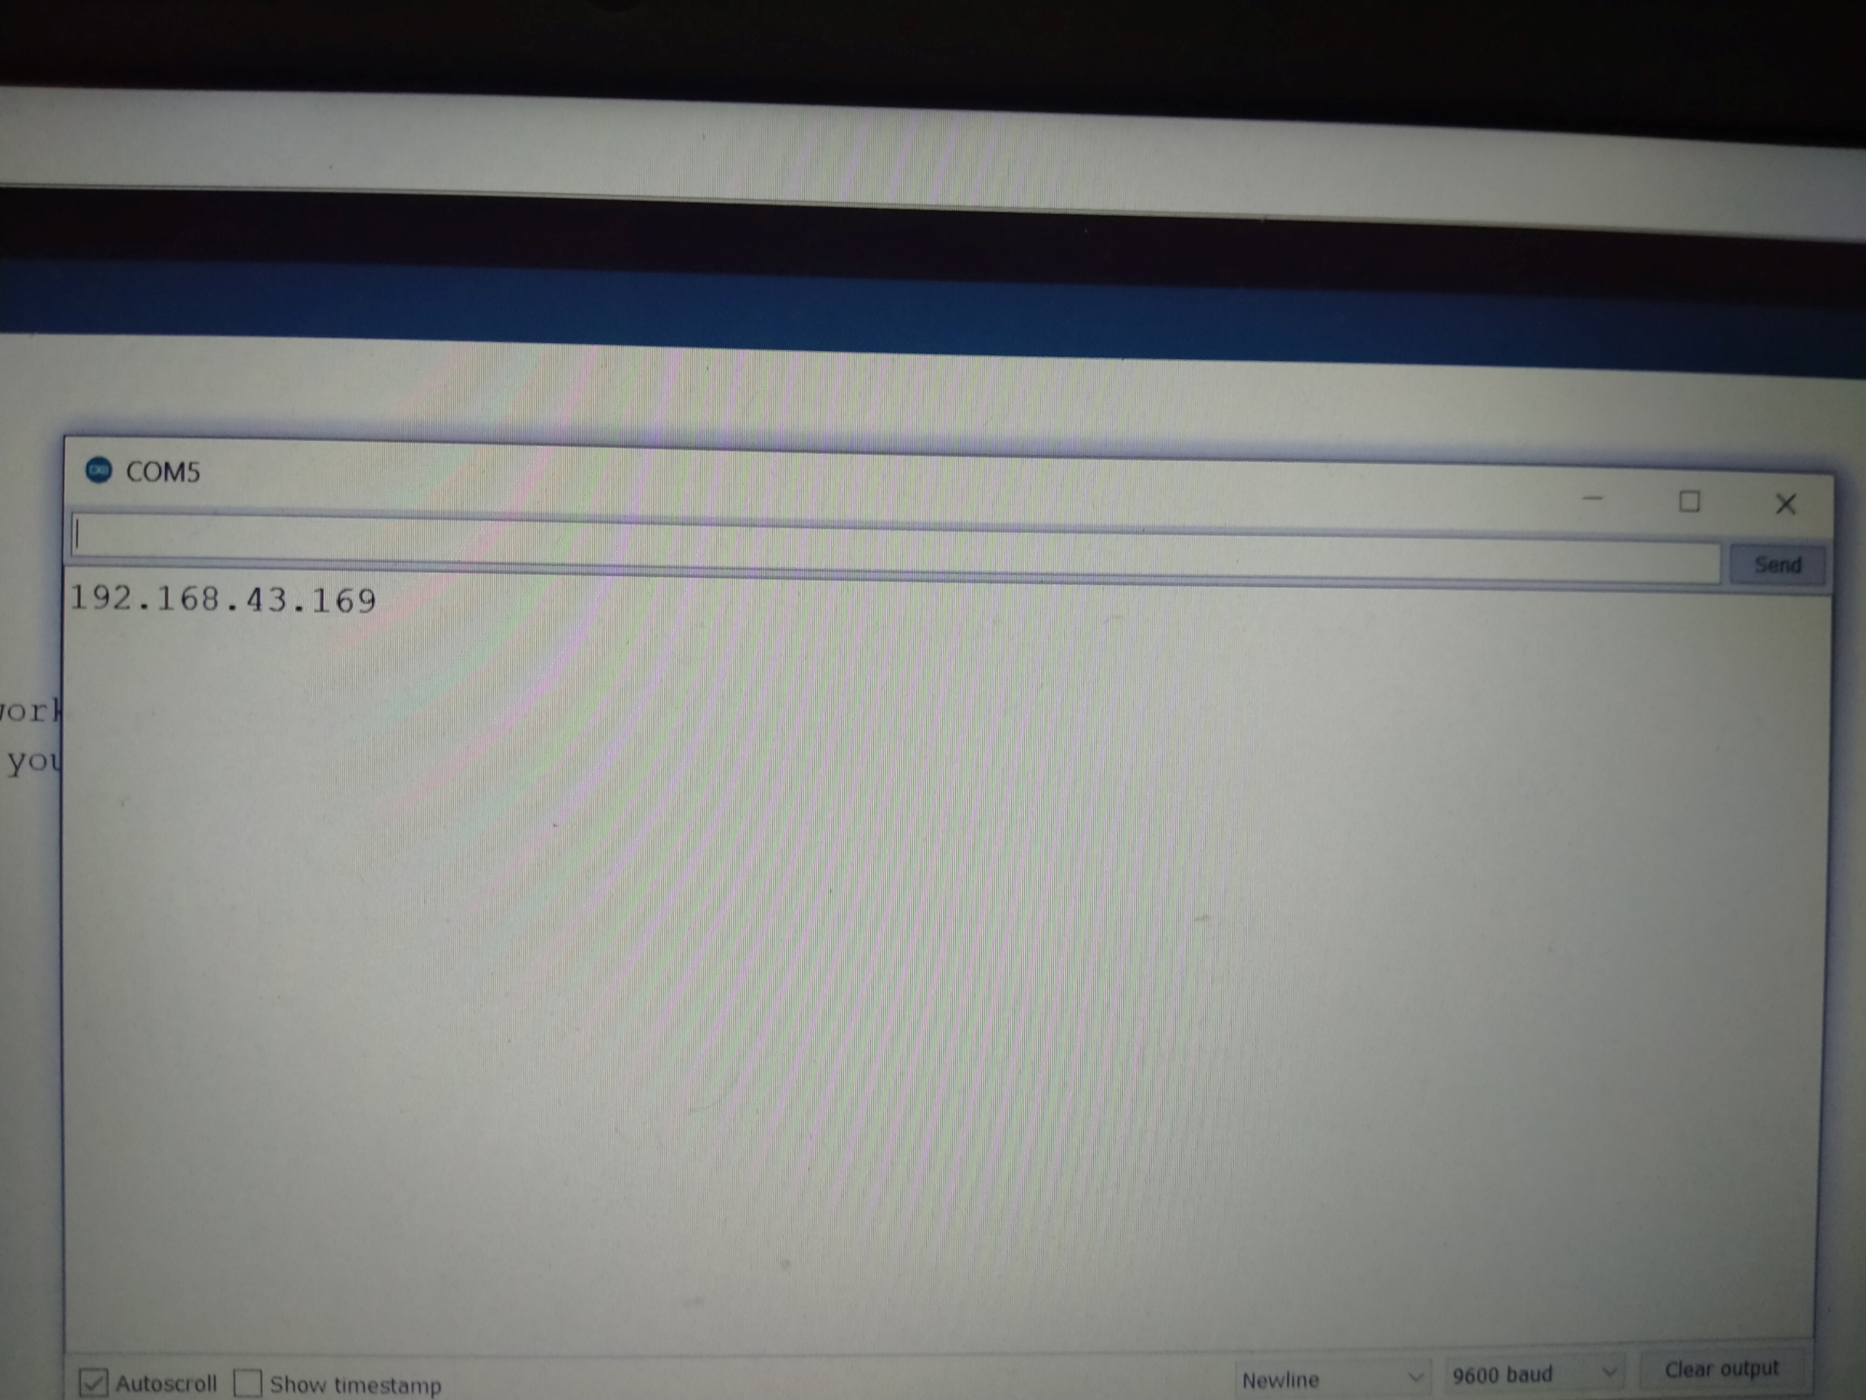
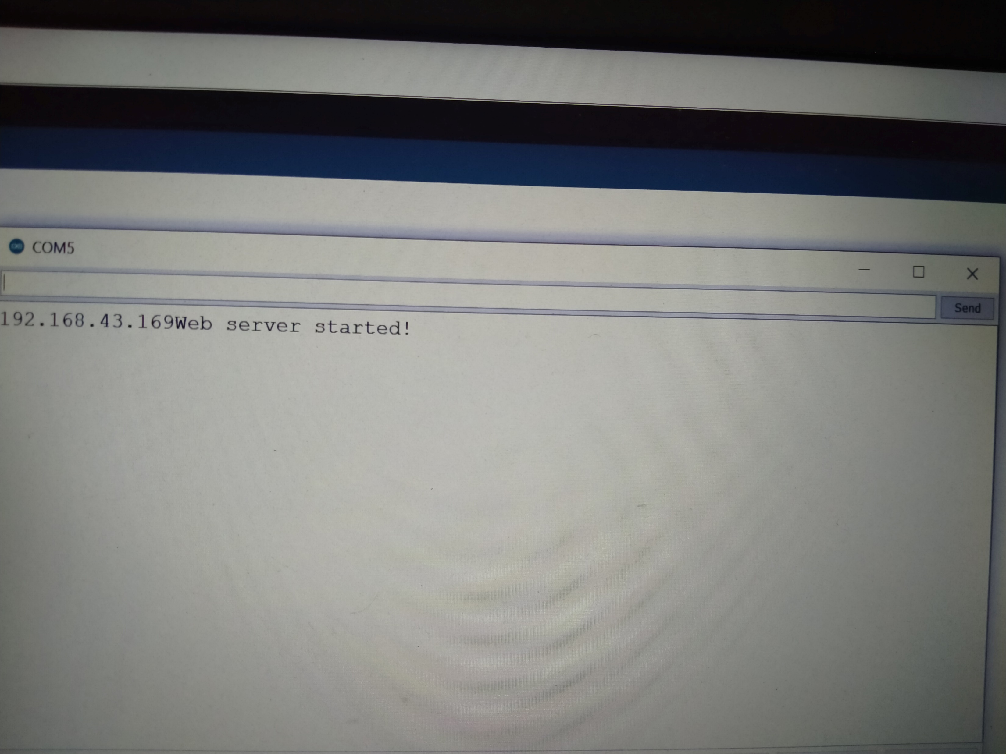
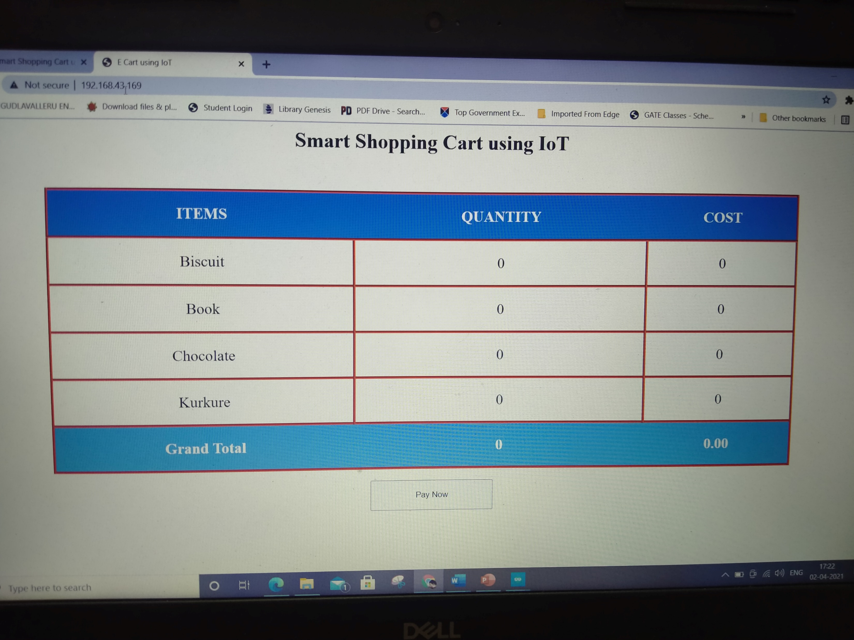
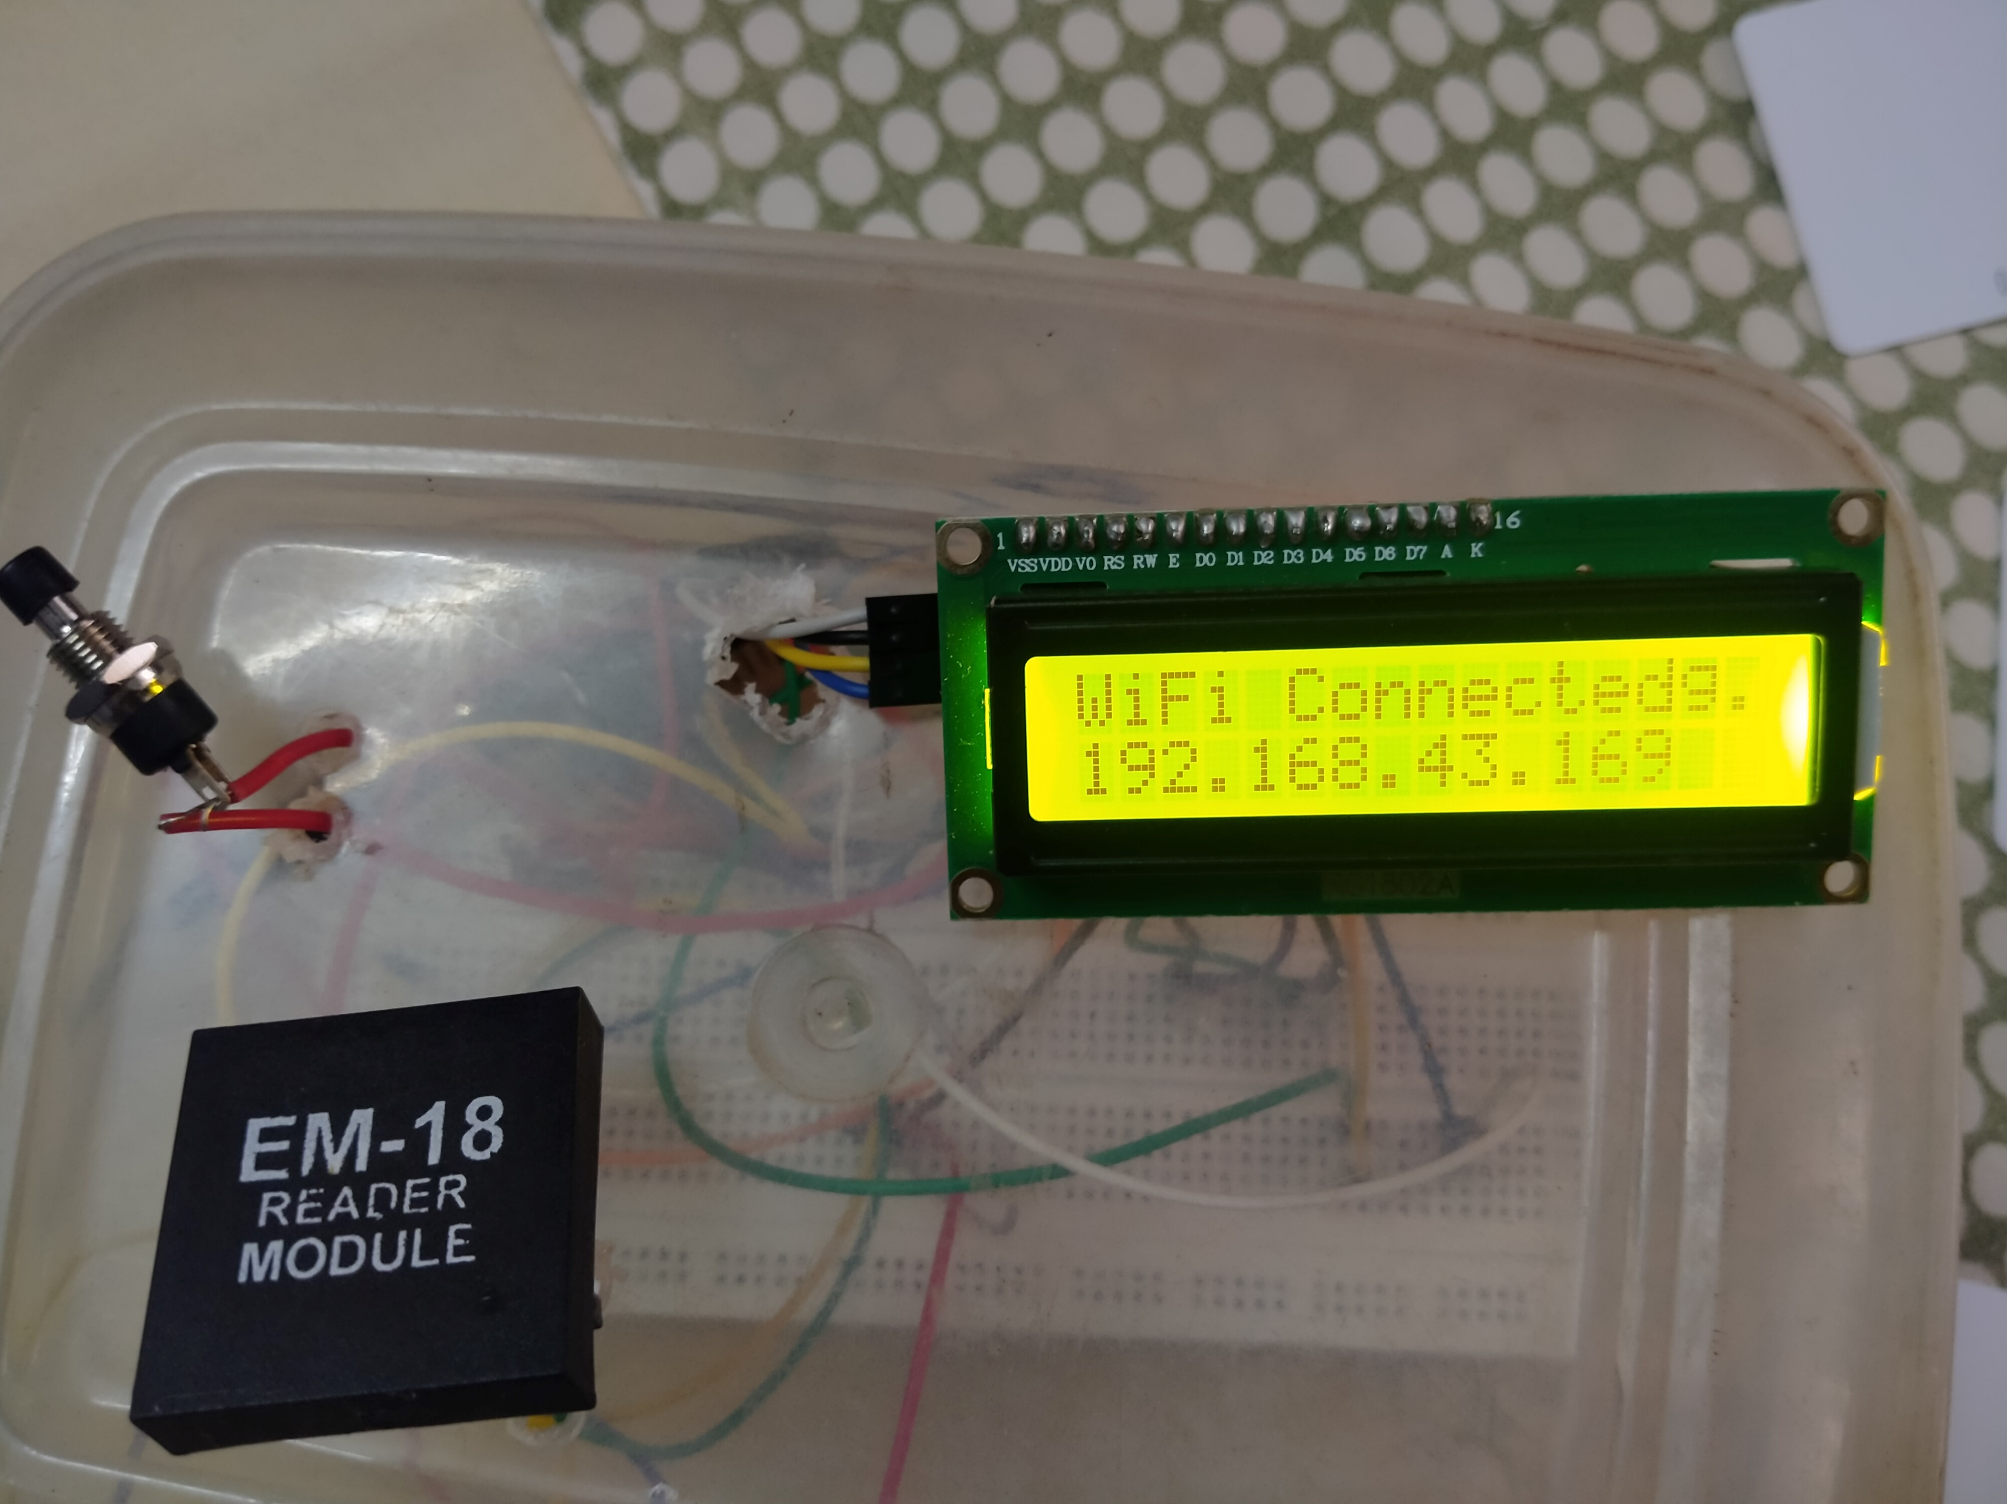
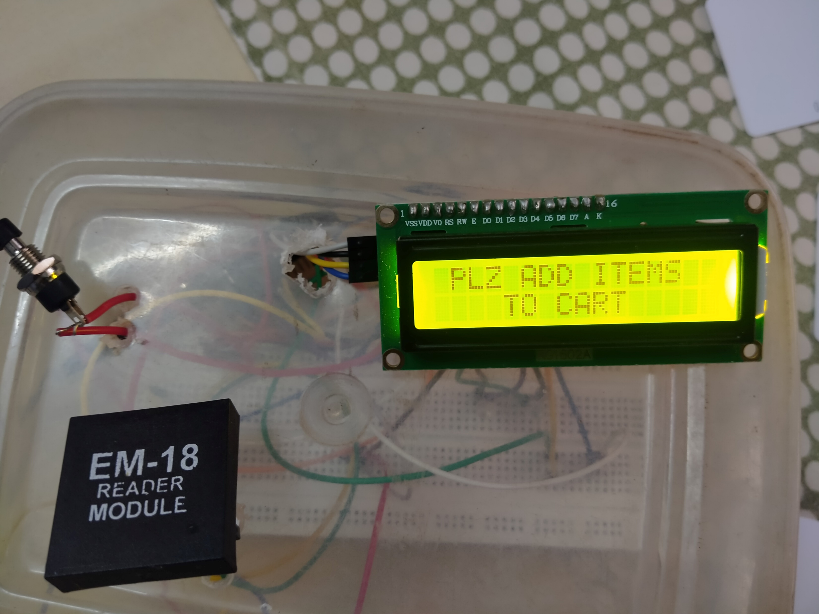
WiFi and webpage connected

Slide 13
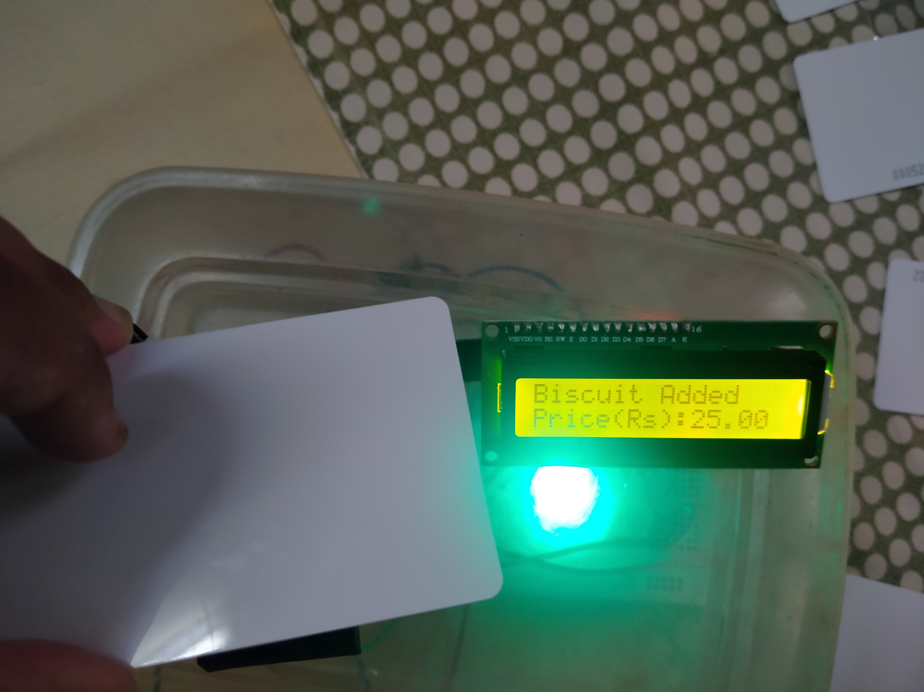
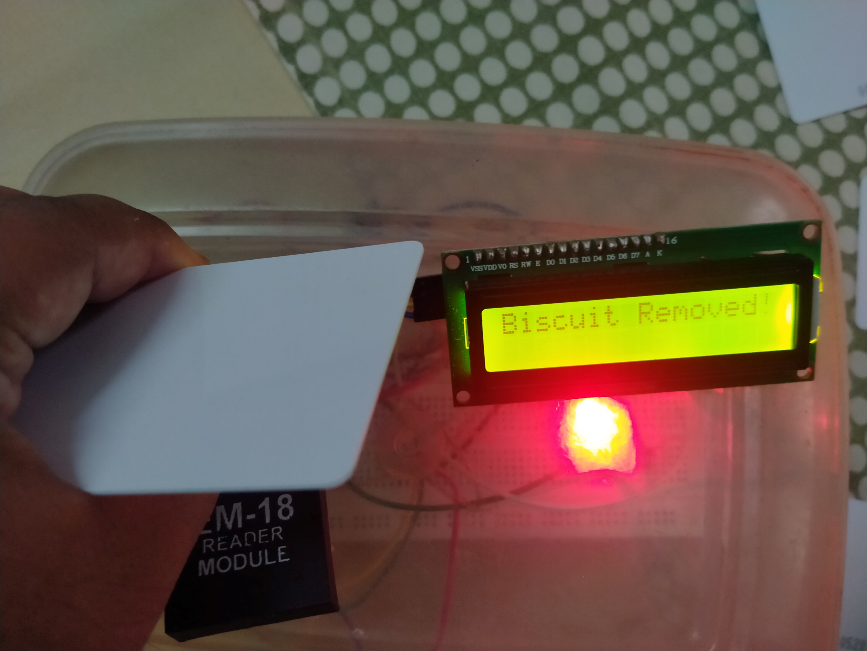
Adding and removing items

Slide 14
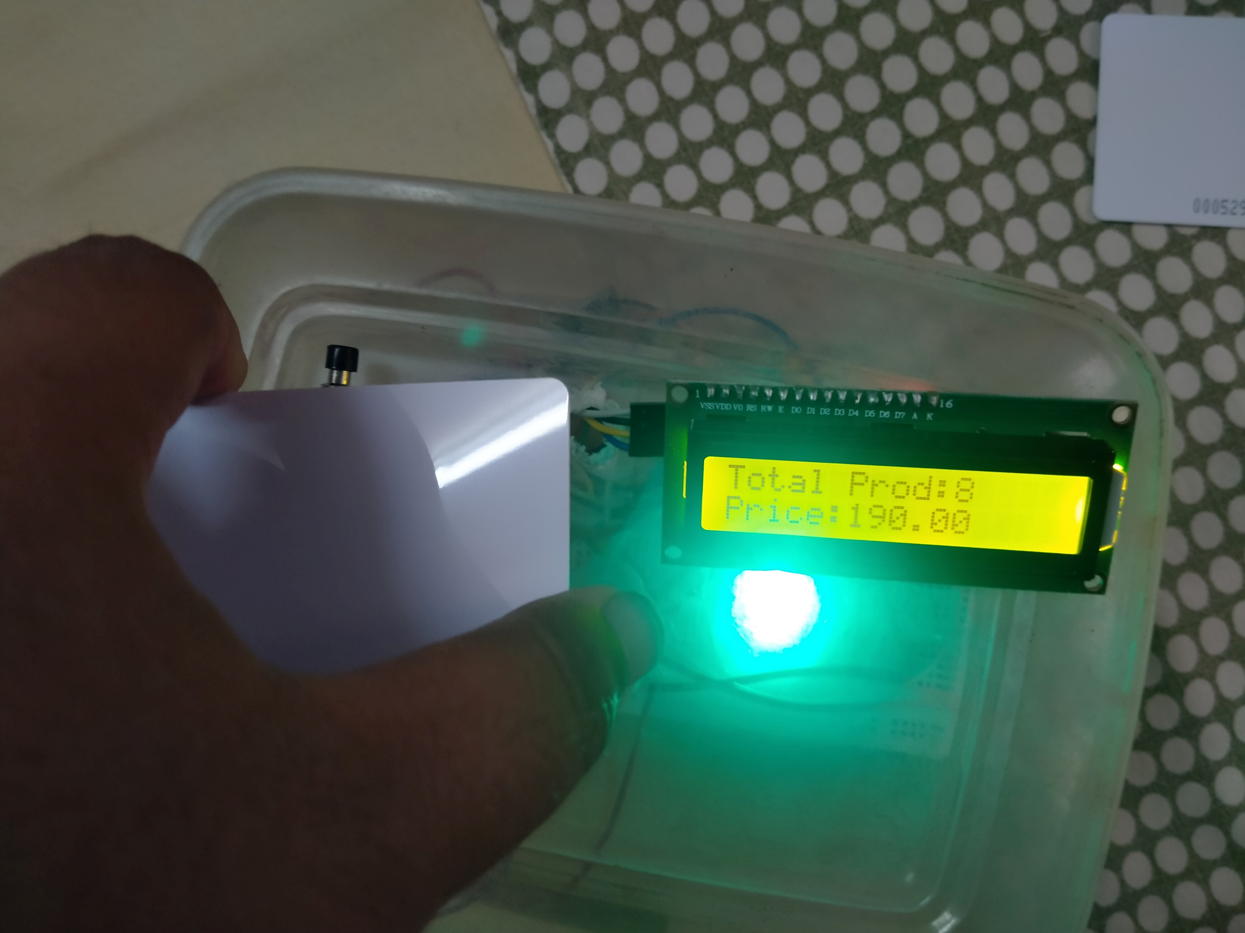
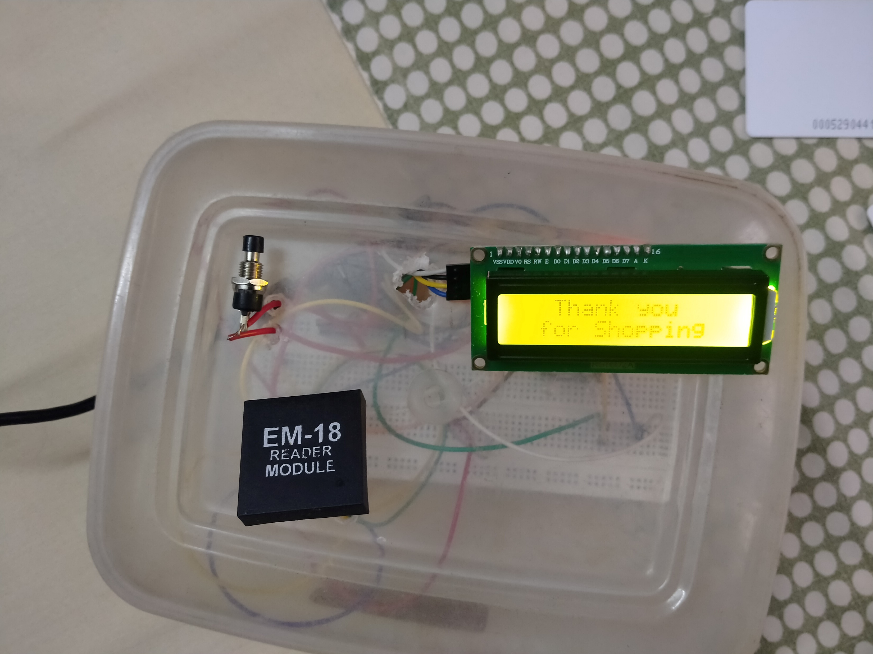
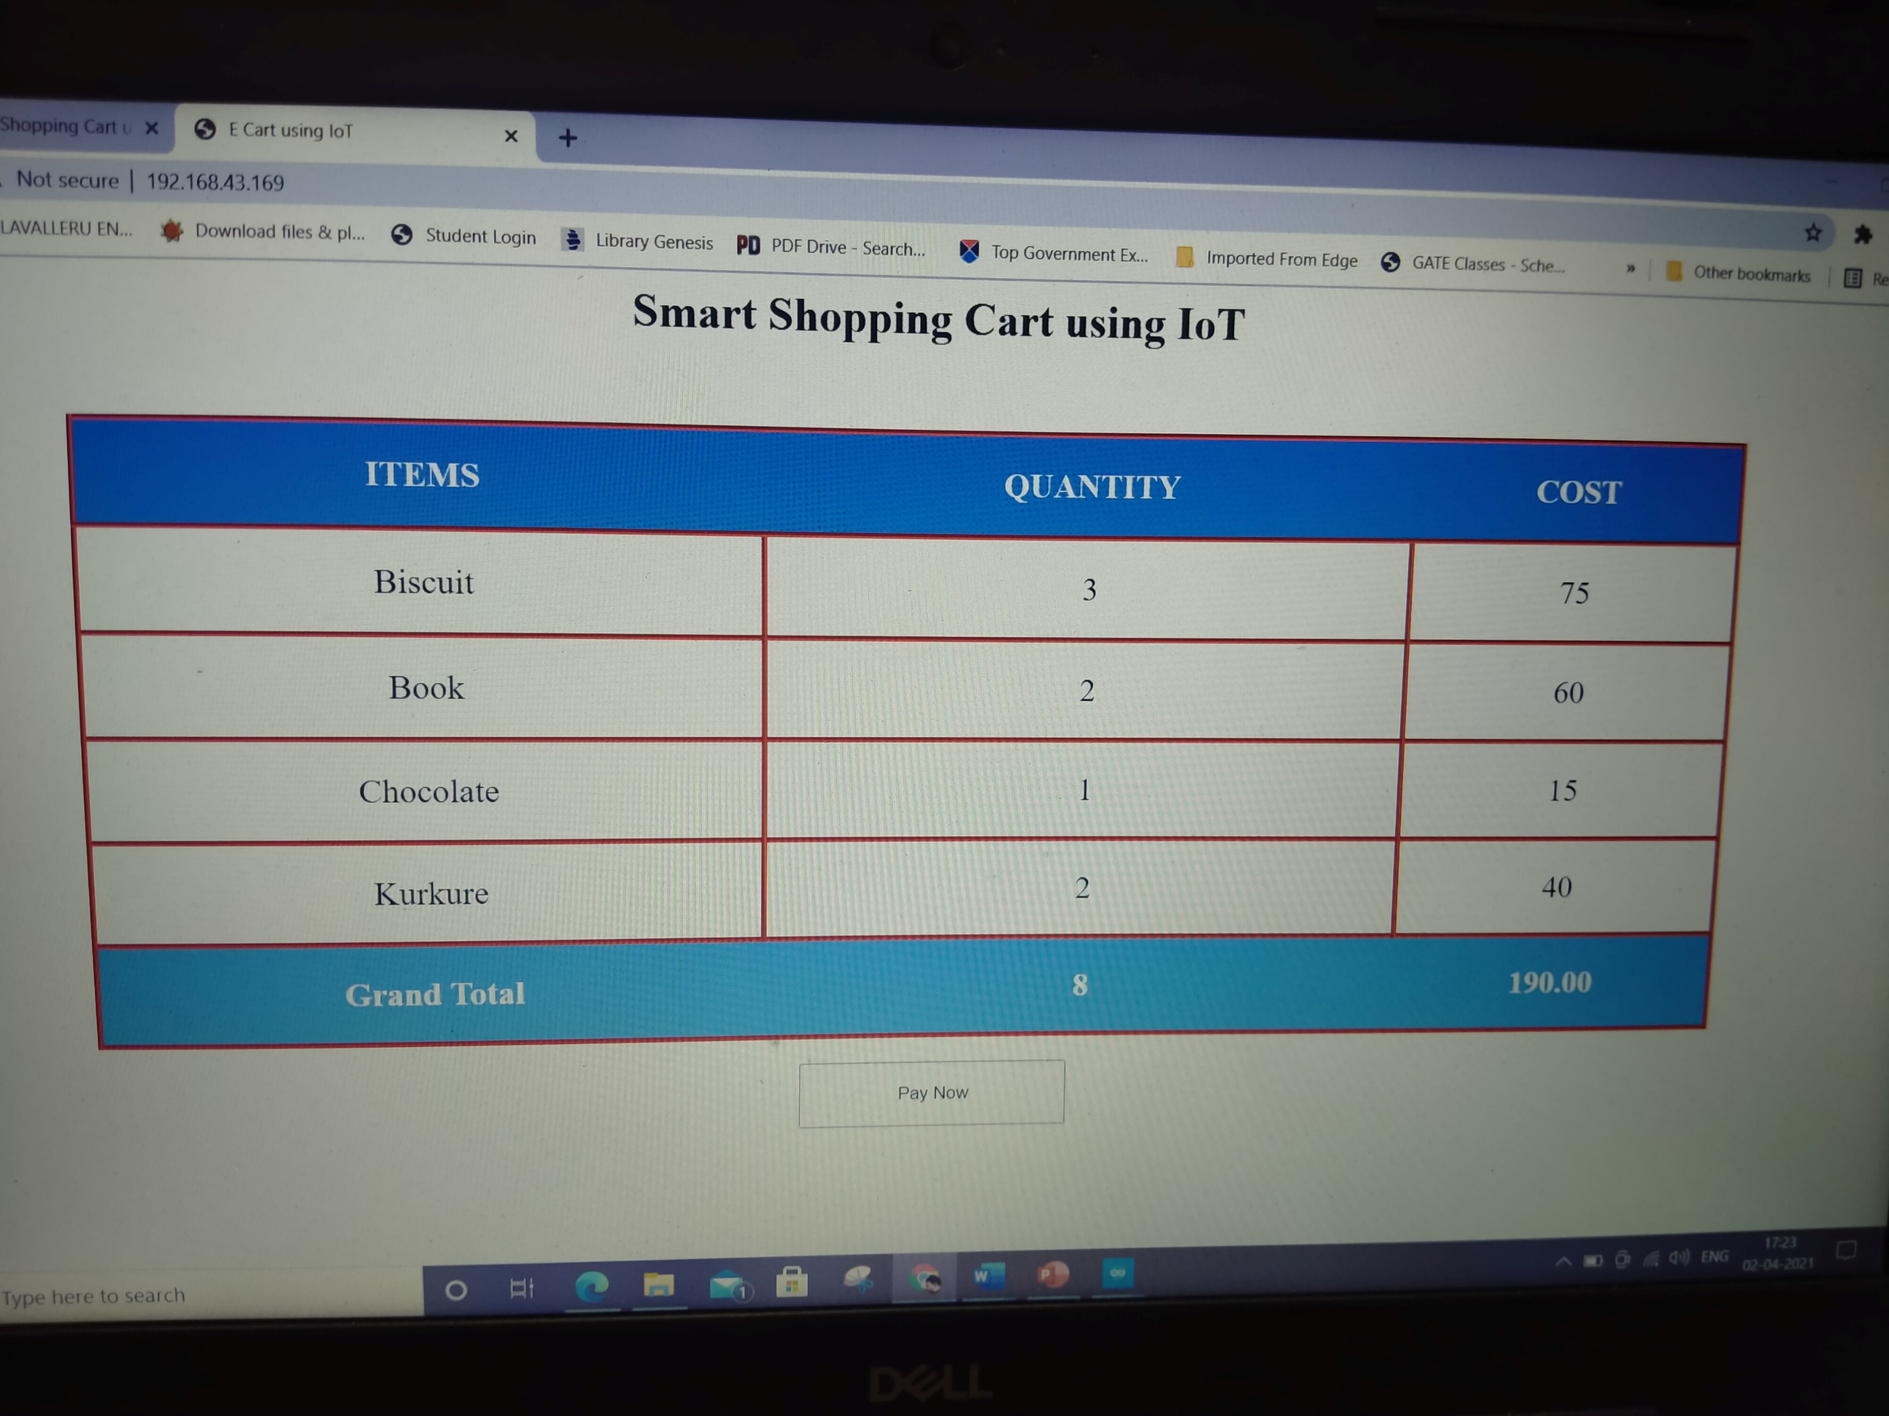
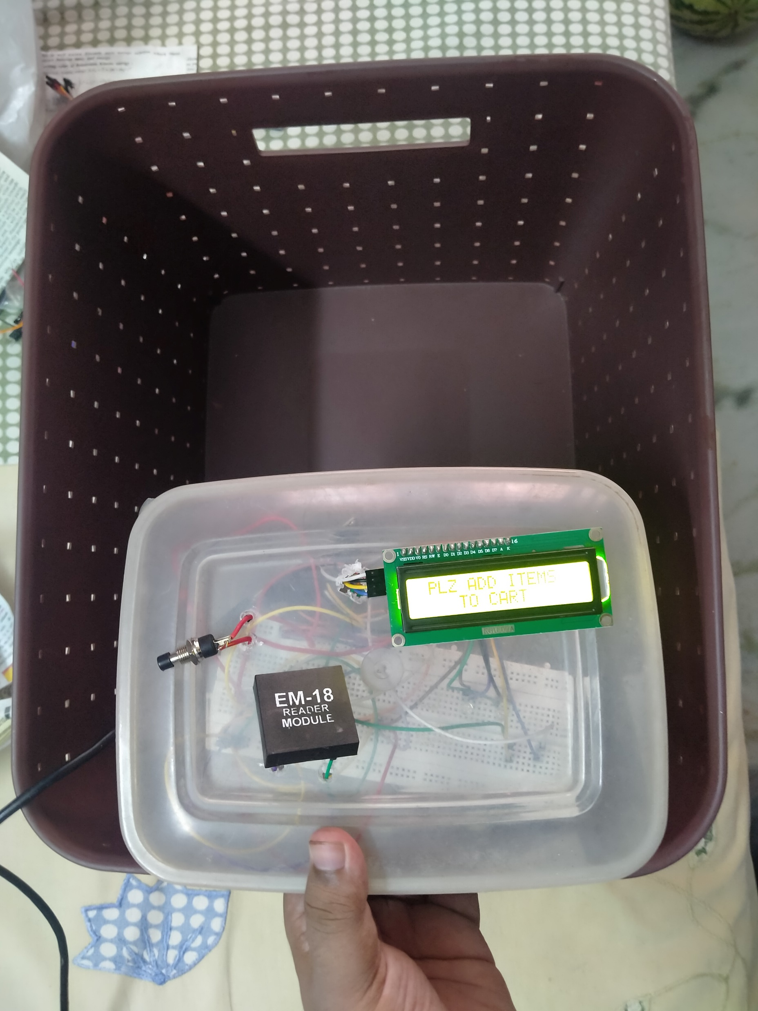
Grand total and billing

Slide 15
Conclusion
The proposed model is easy to use, low priced and does not require any special training. This model keeps an account and uses of the existing developments and various types of radio frequency identification and detection technologies which are used for item recognition, billing and inventory update. As the whole system is becoming smart, the requirement of manpower will decrease, thus benefiting the retailers.
Automatic billing of products by using RFID technique will be a more viable option in the future. The system based on RFID technique is efficient, compact and has promising performance. Also, RFID is better and faster than barcode reading because the later works on line of sight which is not the case for RFID technique. This will take the overall shopping experience to a different level. Different parameters such as the system parameters of smart trolley like product name, product cost, product weight etc. Are display.

Slide 16
FUTURE SCOPE
The RFID based smart trolley using IoT can be extended for implementing many other functionalities like:
Transfer the bill to mobile without printing we can use the GSM module.
Robotics arm also include in it for the picking and dropping of the product.
We can also include voice assistance.
We can extend it to pay bills using debit/credit card and also UPI banking.

Slide 17
References
Suraj.S, vishal guruprasad, udayagiri R pranava, preetham S nag, RFID based wireless intelligent cart using ARM7 international journal of innovative research in science, engineering and technology, vol. 5, issue 8, 2016.
Komal ambekar, vinayak dhole, supriya s smart shopping troll using rfid international journal of advanced research in computer engineering & technology (ijarcet), volume 4 issue 10, 2015.
Https://create.Arduino.Cc/projecthub/electropeak/getting-started-w-nodemcu-esp8266-on-arduino-ide-28184f
Https://www.Instructables.Com/mfrc522-rfid-reader-interfaced-with-nodemcu/

Slide 18
Thank you
Any Queries
?

